Slide 1
TEA SHOP BUSINESS PLAN

Slide 2
Executive summary
Tea time shop is a new tea room in Florida, USA. Tea time is a constrained legal responsibility company, controlled by way of its proprietor. The managers’ love and know-how of teas will make the transition to proudly owning and strolling a teahouse a herbal step. Jasmine Tea time will provide a full variety of teas (warm and iced), as well as pastries, premium goodies, tea add-ons, and loose teas for taking domestic or giving as items. The manager is a grasp tea tender and has been learning right brewing techniques from her for the final four months. we can train all of our tea tenders inside the proper storage, brewing, and serving of each sort of tea.

Slide 3
Executive summary
the yank tea marketplace is developing swiftly. Tea income have elevated one hundred sixty five% over the last fifteen years, with the number of tea rooms supplying sit down carrier rising about 15% to approximately 1,500 shops. American interest in tea simply owes a number of its growth to the proliferation of gourmand espresso stores across the on this same duration. most of running the USA has well-known the concept of steeply-priced warm liquids as low priced luxuries, thanks to the advertising efforts of Starbucks, Seattle’s first-rate, and so on. on the same time, style is usually on the circulate – now that fancy coffee beverages are so extensively generic, savvy customers are looking for new, extra specific treats to enjoy. Starbucks estimates that 7% of its $12 billion annual sales presently come from tea. In Simsbury, our ability clients is split between neighborhood citizens and tourists. We assume to without problems generate sales to current devoted tea drinkers, who will right away understand the nice of our services and products. marketing to the tons larger local corporations who are not yet acquainted with top rate teas will emphasize our atmosphere, our prestige-value sales to tourists depend upon a incredibly-seen area, association with the quaint appeal of our city, and promotional efforts in cooperation with different nearby agencies.

Slide 4
Products and Services
Tea time will focus on top class teas, great goodies, and present baskets. Our full “tea time” experience is complemented by using an assortment of loose teas, top rate candies, tea add-ons and present baskets, all suitable as souvenirs and gifts for our visitor customers. Our intention is to be a destination store for traffic, and a aid for locals searching for items, new studies, and know-how of tea.

Slide 5
Market size of the products
Tea is the second most widely fed on beverage worldwide and in Florida, following simplest water. In 2018, worldwide tea production amounted to about five. the recent drinks marketplace segment, Tea, consists of black tea, green tea and mate offered in tea bags or as free-leaf tea. This phase does not encompass natural tea, immediate tea, iced tea or similar tea-derived geared up-to-Drink drinks.

Slide 6
Growth of the market.
The global tea market size was estimated at USD 13.31 billion in 2019 and is anticipated to reach USD 14.02 billion in 2020. ... the worldwide tea marketplace is expected to develop at a compound annual boom rate of five.5% from 2019 to 2025 to reach USD 18.forty two billion by using 2025.

Slide 7
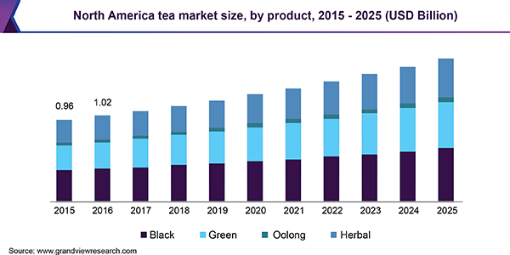

Slide 8
increasing purchaser disposable earnings and willingness to spend greater on cash on an expansion of merchandise encourages manufacturers to introduce top rate and specific blends. they've brought various healthful substances in their tea blends, to target some of the not unusual fitness situations which include diabetes, obesity, and coronary heart diseases among others. rising software in splendor and cosmetic industries is predicted to further fuel the market growth. Black, inexperienced, and natural teas are the maximum desired product kinds among customers throughout the globe. green tea is known for its antioxidant residences therefore is increasingly consumed by pregnant ladies, fitness aware people, and the older populace. Oolong tea is the combination of each black and inexperienced tea and is determined effective for preventing excessive blood cholesterol levels and kind 2 diabetes. The product is pretty famous in China and Japan. inexperienced and natural teas which includes chamomile and jasmine are also extensively used as a remedy for blemish-loose pores and skin and healthy hair thereby propelling the product call for.

Slide 9
Advantages of tea business
access to herbal sources which can be restrained from competitors
enormously skilled hard work
a unique geographic place
access to new or proprietary technology
capability to fabricate products at the lowest cost
emblem photograph popularity

Slide 10
PRICING Cost of Goods Sold, Expenses and Markup
Each business has to do one easy element to be sustainable – bring in greater sales than money spent. That being said, the cash a business spends is divided into huge categories: cost of goods offered and charges.

Slide 11
Refining the document
expertise Camellia Sinensis- the mystical Plant
realize Your middle Competency
identify Your target audience & advertising approach
Product Packaging
Procurement and storage of Teas
passion

Slide 12
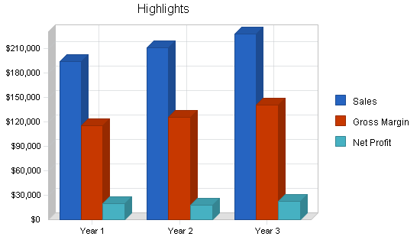
Image of tea sales, gross marging and net profit

Slide 13
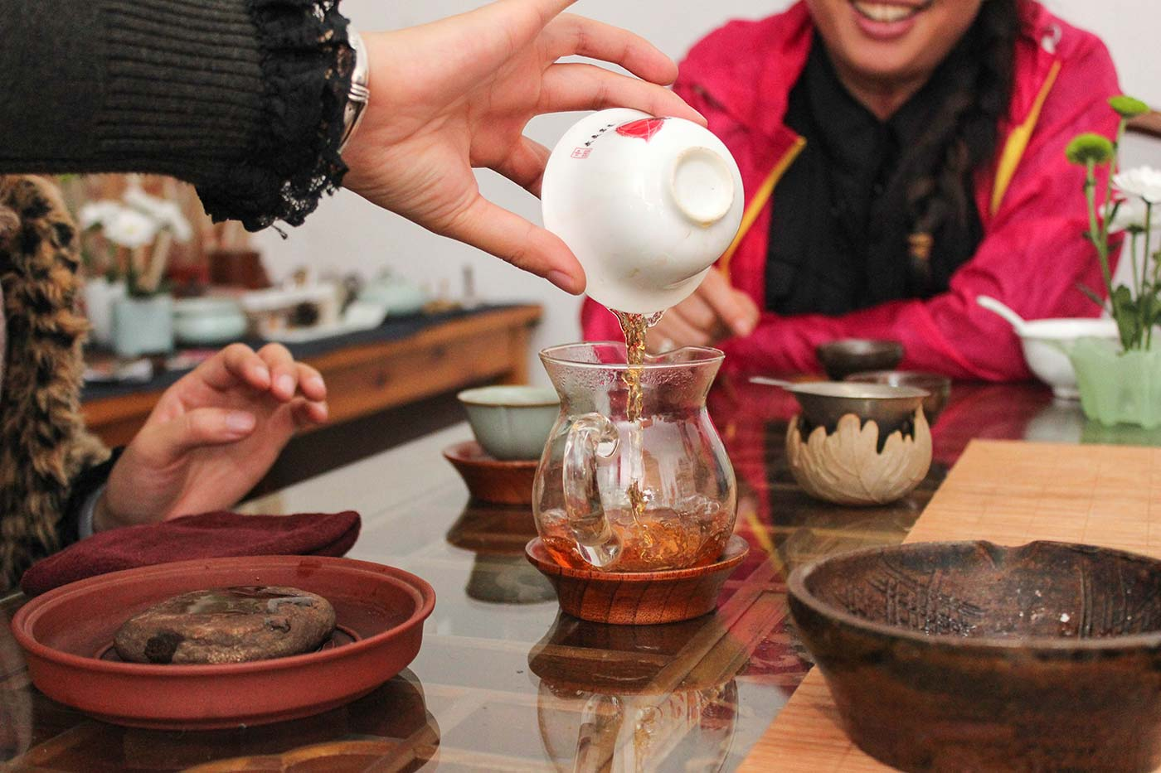
An image of tea being served in a tea shop

